Slide 1
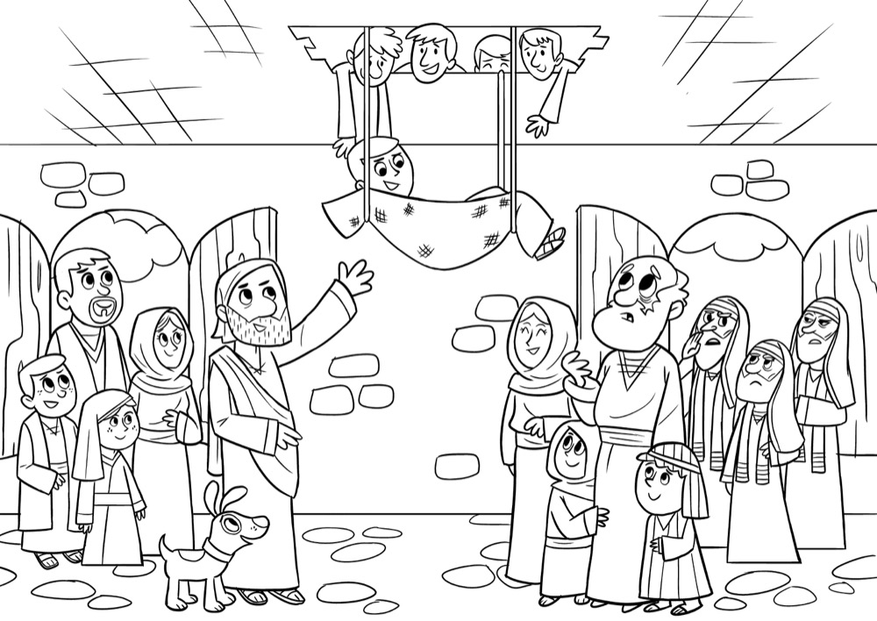
Mark 2: 1–12
In the speech bubble, write down kind words Jesus would say to comfort those that are sick or suffering.
Notes:
Pittsy, Jenn. “Jesus Heals a Paralyzed Man Coloring Page.” Pinterest, Pinterest, www.pinterest.ca/pin/452189618832104144/.

Slide 2
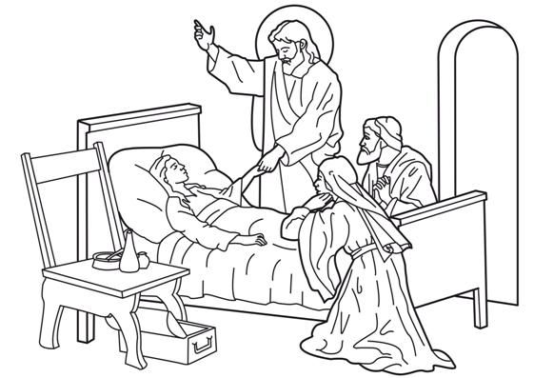
Mark 5: 35–43
In the speech bubble, write down kind words Jesus would say to comfort those that are sick or suffering.
Notes:
Bible Kids. “Jesus Heals the Sick Girl.” Bible Kids , Bible Kids, www.biblekids.eu/new_testament/miracles_ of_ Jesus/miracles_ of_ Jesus_coloring/Jesus_ heals_ the_ sick_11.jpg.

Slide 3
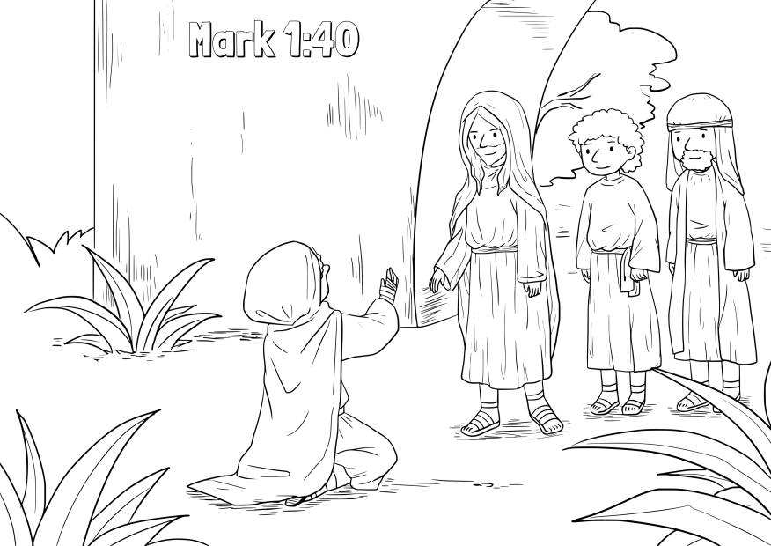
Mark 5: 21–32
In the speech bubble, write down kind words Jesus would say to comfort those that are sick or suffering.
Notes:
Regoli, Natalie. “Jesus Heals Leper.” ConnectUsFund, ConnectUsFund, 25 May 2020, connectusfund.org/jesus-heals-the-leper-coloring-pages.

