Slide 1
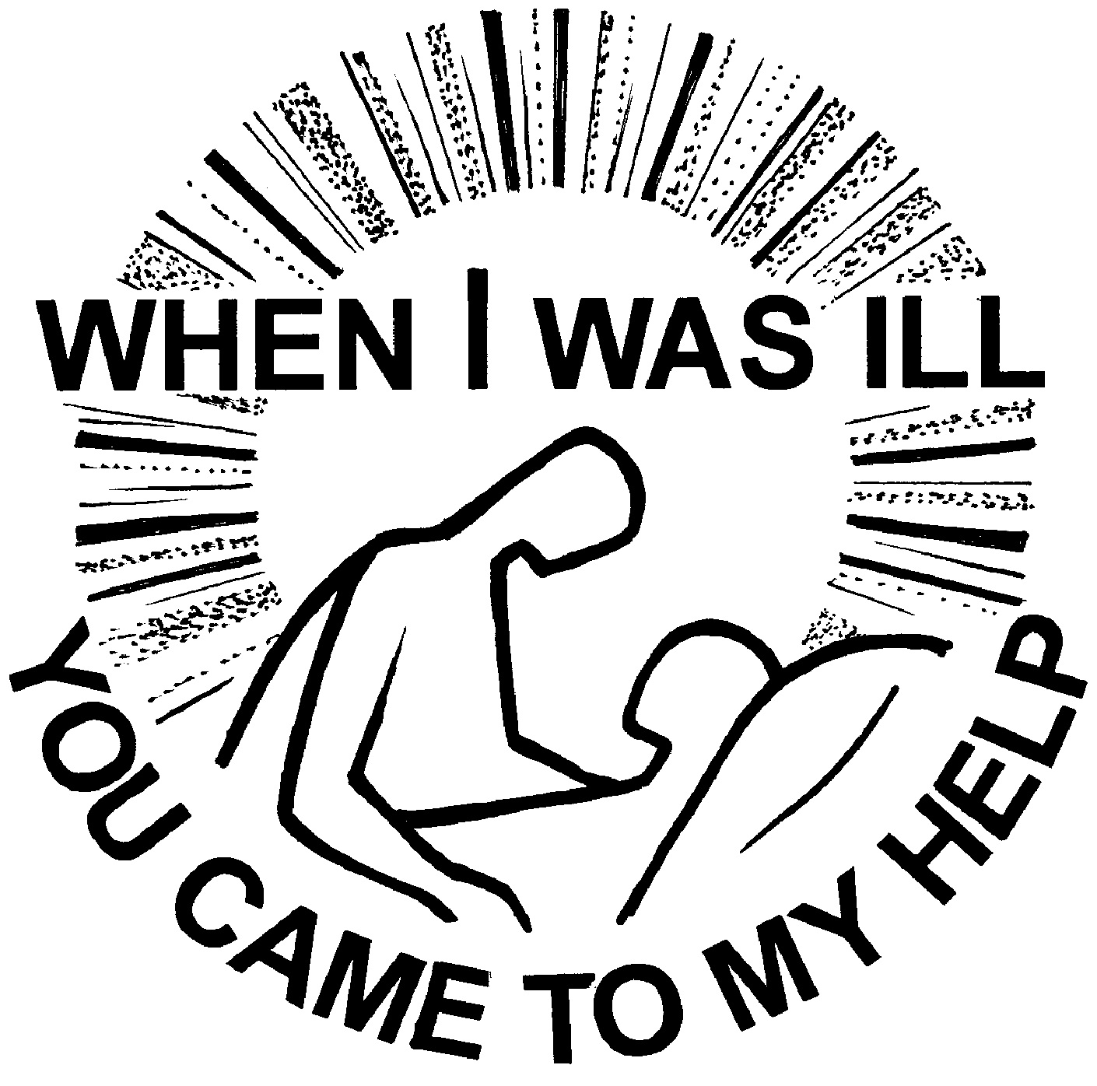
World Day of the Sick 2023

Slide 2
Pope Francis’ Message
“Illness is part of our human condition. Yet, if illness is experienced in isolation and abandonment, unaccompanied by care and compassion, it can become inhumane…It is precisely in such moments that we see how we are walking together: whether we are truly companions on the journey, or merely individuals on the same path, looking after our own interests and leaving others to “make do”.”
He invites us “to reflect on the fact that it is especially through the experience of vulnerability and illness that we can learn to walk together according to the style of God, which is closeness, compassion, and tenderness”.
Pope Francis. “31th World Day of the Sick 2023 | Francis.” The Holy See, 10 January 2023, https://www.vatican.va/content/francesco/en/messages/sick/documents/20230110-giornata-malato.html. Accessed 12 January 2023.

Slide 3
THE GOOD SAMARITAN

Slide 4
What are some characteristics
of a Good Samaritan?
List the responses here:

Slide 5
THINK
PAIR
SHARE
Share a time where you either were a Good Samaritan or you witnessed someone being a Good Samaritan?
What did you/they do and why?
What makes it difficult to be a Good Samaritan?

Slide 6
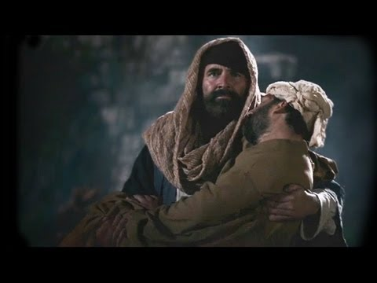
As you watch the video, take note of all the actions that the Good Samaritan does for the injured man.
Notes:
The Church of Jesus Christ of Latter-day Saints. “Parables of Jesus: Parable of the Good Samaritan.” YouTube, YouTube, 26 September 2019, https://www.youtube-nocookie.com/embed/53Pqw20xK10?playlist=53Pqw20xK10&autoplay=1&iv_load_policy=3&loop=1&modestbranding=1&start=. Accessed 12 January 2023.

Slide 7
In your groups, draw two mind maps and jot down how each person felt during this encounter.
Good Samaritan
Injured Man

Slide 8
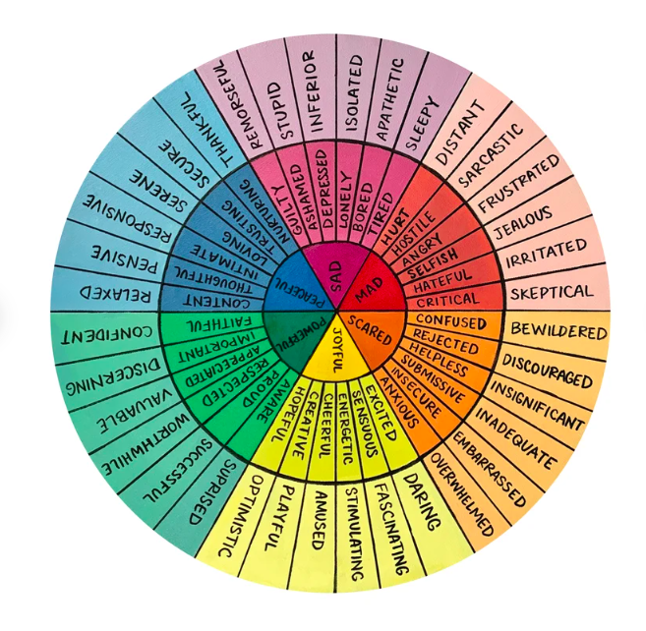
Notes:
ElissaSurabianArt. “Emotions Color Wheel Art Print.” Etsy, ElissaSurabianArt, https://www.etsy.com/ca/listing/990728633/emotions-color-wheel-art-print?gpla=1&gao=1&&utm_source=google&utm_medium=cpc&utm_campaign=shopping_ca_en_ca_c-art_and_collectibles-other&utm_custom1=_k_CjwKCAiAk--dBhABEiwAchIwkfI9jOce2sdSI5kgfBBdjARn-Xjb6pSAejhMc. Accessed 12 January 2023.

Slide 9
Pope Francis’ Key Takeaway #1
“Here it is especially important to recognize the condition of loneliness and abandonment. This kind of cruelty can be overcome more easily than any other injustice, because – as the parable tells us – it only takes a moment of our attention, of being moved to compassion within us, in order to eliminate it.
Two travellers, considered pious and religious, see the wounded man, yet fail to stop. The third passer-by, however, a Samaritan, a scorned foreigner, is moved with compassion and takes care of that stranger on the road, treating him as a brother. In doing so, without even thinking about it, he makes a difference, he makes the world more fraternal.”
Pope Francis. “31th World Day of the Sick 2023 | Francis.” The Holy See, 10 January 2023, https://www.vatican.va/content/francesco/en/messages/sick/documents/20230110-giornata-malato.html. Accessed 12 January 2023.

Slide 10
BEING A GOOD SAMARITAN
What small steps can we take to be a Good Samaritan?
Choose not to look away
Be tolerant
View others as your neighbour
Don’t hesitate to reach out first
Put aside selfish thoughts
Gives others hope that our world can be and do better
Could restore someone’s faith in humanity
This kind act could motivate them to pay it forward

Slide 11
Pope Francis’ Key Takeaway #2
“The World Day of the Sick calls for prayer and closeness towards those who suffer. Yet it also aims to raise the awareness of God’s people, healthcare institutions and civil society with regard to a new way of moving forward together…
Indeed, the conclusion of the parable of the Good Samaritan suggests how the exercise of fraternity, which began as a face-to-face encounter, can be expanded into organized care. The elements of the inn, the innkeeper, the money and the promise to remain informed of the situation (cf. Lk 10:34-35) all point to the commitment of healthcare and social workers, family members and volunteers, through whom good stands up in the face of evil every day, in every part of the world.”
Pope Francis. “31th World Day of the Sick 2023 | Francis.” The Holy See, 10 January 2023, https://www.vatican.va/content/francesco/en/messages/sick/documents/20230110-giornata-malato.html. Accessed 12 January 2023.

Slide 12
HEALTHCARE
WORKERS
=
GOOD SAMARITANS
Referring back to the list of actions that the Good Samaritan did for the injured man, can you think of similar examples of what a healthcare worker would do to care for the sick?
Can anyone share a story of a healthcare worker who took good care of you while you were sick or injured or who went above and beyond to help others to feel better?

Slide 13
THANK
YOU
CARDS
Write a thank you message to a general healthcare worker.
Try to thank a healthcare worker for a specific action, just like the ones the Good Samaritan did for the injured man.

Slide 14
PRAYER
INTENTIONS
FOR
HEALTHCARE
WORKERS
We pray for healthcare workers who _______________________________________ each day to care for the sick and injured.
We pray that God will bless and help them by _____________________________.
For this we pray to the Lord.
R: Lord, hear our prayer.

