Slide 1
Anne Whitford-Fast and Lynn Granke
November 4, 2020

Slide 2
Grief
A normal and natural reaction to any type of loss
Grief is normal and we all grieve in different ways.

Slide 3
Anticipatory Grief
This occurs prior to the actual event or loss.
Pre-Pandemic: as a loved one is dying, we begin anticipating/imagining life without them; anticipating our grief.
Pandemic: anticipating future losses; will my PPE protect me?
Will I lose my job?
What if my child gets sick? I won't be able to go to work? How will I pay the bills?
What if we’re in code red during the holidays and we can’t gather as a family?

Slide 4
Disenfranchised or Ambiguous Grief
Not validated by society , not acknowledged as a significant loss
The loss may not be a death: loss of a child placed for adoption, foster care for example.
Grief that has no obvious, recognizable source. Not something we officially mourn.
No rituals or acknowledgment. ( no sympathy card for this one!)
Unacknowledged feelings lead to feeling unsettled
Often trivialized or minimized
Pre-Pandemic: a relative who is living with addictions with whom we have minimal contact; not deceased and not part of our life. Having a family member with dementia
Pandemic: losing our confidence in terms of the future, loss of a sense of control over our life.
Notes:
In June gr 12 grads didn’t have the grad they imagined; wedding season was hugely impacted as people changed plans to accommodate a group of 50
Loss of favoiurite restaurant, personal freedom, normalcy and dreams

Slide 5
Cumulative Grief/Hidden Grief
The grief of a thousand cuts. Cut upon cut; Pain piled on pain; fear on fear.
Persistent, ongoing, cumulative. Losses of all sizes can build up and lead to a person feeling overwhelmed.
Normally, a single event of grief or even 2 or 3 can be managed.
Pandemic: the ongoing frequency and accumulation of losses creates feelings of sadness, powerlessness, disorientation, anxiety and depression.
Notes:
Example of events: my Best Friend at Work gets reassigned, my father moves from his assisted living into a PCH; or my kids hamster dies and the neighbours next door whom we trust and like move away and my hours at work are reduced.
Pandemic: favourite restaurant closes for good, your daughter can’t come home from Nova Scotia, Thanksgiving dinner, 65th birthday celebration, high school graduation

Slide 6
Collective Grief
Grief felt by a collective group such as a community, society or nation as a result of an event such as a war, natural disaster, terrorist attack, death of a public figure, or any other event leading to mass casualties or national tragedy.
Pre-Pandemic: Humboldt, Remembrance Day
Pandemic: the Pandemic

Slide 7
Comparative Suffering
Comparative suffering is seeing one’s suffering in light of other people’s pain
Compared to your suffering....mine is nothing… yet it still hurts
Ranking our suffering results in denying our feelings
Comparative suffering silences us, shuts us down
On top of our grief and sadness, comparing our suffering adds anger, fear, worry, withdrawal
Pain is pain; everyone deserves to feel their feelings
Notes:
How can I complain when I know people who have things so much worse?
Denying our feelings doesn’t make us feel better. Imagine your finger just got slammed in the door…”that’s not so bad…Terry has a broken arm…that hurts way more”
Does this lessen the pain in the moment?
Silences us, shuts us down, says” you don’t have a right to feel …your feelings are wrong, invalid”…this isolates us

Slide 8
Pre-Pandemic: I‘m in the midst of a divorce and ugly custody battle but can’t complain, my friend lost her job and was just diagnosed with breast cancer!
Pandemic: I’m very tired and frustrated with home schooling my 4 kids and trying to work from home and the house is an upside-down mess with us all home…and did I mention I still have to cook and clean each day?! But I can’t complain, I still have a job and my family is healthy so far

Slide 9
Feeling our feelings ...keeping perspective remembering that “perspective is a function of experience.” - Brené Brown
As adults we model the expression of feelings. We give permission for our children and others to feel their feelings and set them in perspective
Allow our feelings expression AND keep our struggles in perspective
Compassion for ourselves and each other
Notes:
Brené Brown: the refugee is Syria doesn’t benefit more if you conserve your kindness only for her and withhold from your neighbour who’s going thru a divorce

Slide 10
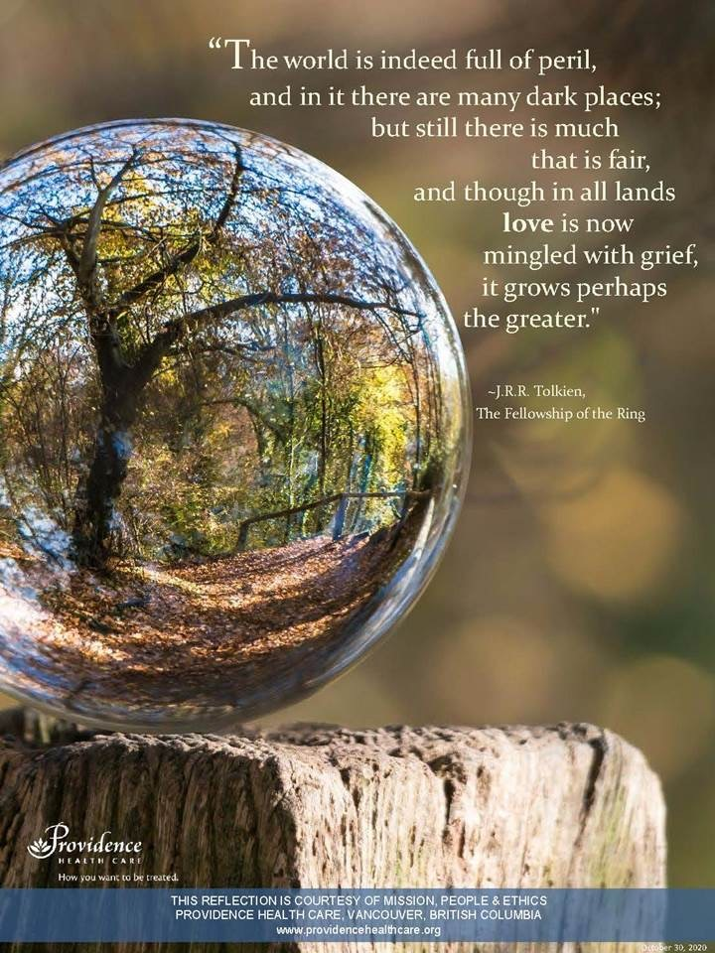

Slide 11
Resources
The Canadian Grief Alliance can be found at www.virtualhospice.ca
The Centre for Addiction and Mental Health, www.camh.ca
For medical professionals: www.albertahealthservices.ca
Virtual Memorial Service, Providence Heatlhcare, BC, www.covid19.providenceheatlhcare.org
Frozen - The Next Right Thing Song: https://youtu.be/gyFub7IuoJQ

Slide 12
